Slide 1

DEPARTMENT OF ELECTRONICS & COMMUNICATION ENGINEERING
A MINI PROJECT PRESENTATION
ON
SMART FLOOR CLEANING ROBOT BY IOT
Presented by:
B .Prasanna [22681A0409]
A .Ramya [22681A0406]
K .Achala [22681A0431]
A .Raghavendra [22681A0407]
Under the esteemed guidance of:
Mr. B. Hanumanthu
Assistant Professor

Slide 2
CONTENTS:
Abstract
Existing system
Proposed system
Block Diagram
Components
Working principle
Applications
Advantages
Expected Results
conclusion

Slide 3
ABSTRACT:
The floor cleaning robot is aims to create an autonomous robot that can clean floors without human intervention. Households of today are becoming smarter and more automated cleaning of floor is very important role in our health and this robot reduces man power requirement. This project is used for domestic purpose to clean the surface automatically.
When it’s turned on it clears the dust by moving around the surface as it passes over it sensors are used to avoid obstacles at the same time brushes attached to the motors to cleans the surface. The approximate battery life is expected to be 45 minutes. This can be useful in improving the lifestyle of mankind. The robot returns to its charging station when the battery is low ensuring continuous operation.

Slide 4
EXISTING SYSYTEM:
Here’s a description of the current methods used to solve the problems of floor cleaning robot using Iot:
Navigation and mapping
Cleaning path optimization
Iot connectivity
Sensors and Actuators
Power management
Security and Privacy
Limitations:
Noise and disturbance
Complexity
Repair costs
Connectivity issues

Slide 5
PROPOSED SYSTEM:
The proposed system “smart clean “ is a WiFi enables, Iot based smart cleaning robot designed to efficiency clean floors while minimizing user intervention.
Advanced sensors
Data analytic
Voice Assistant Integration
Real-time Notification
Mapping and Navigation

Slide 6
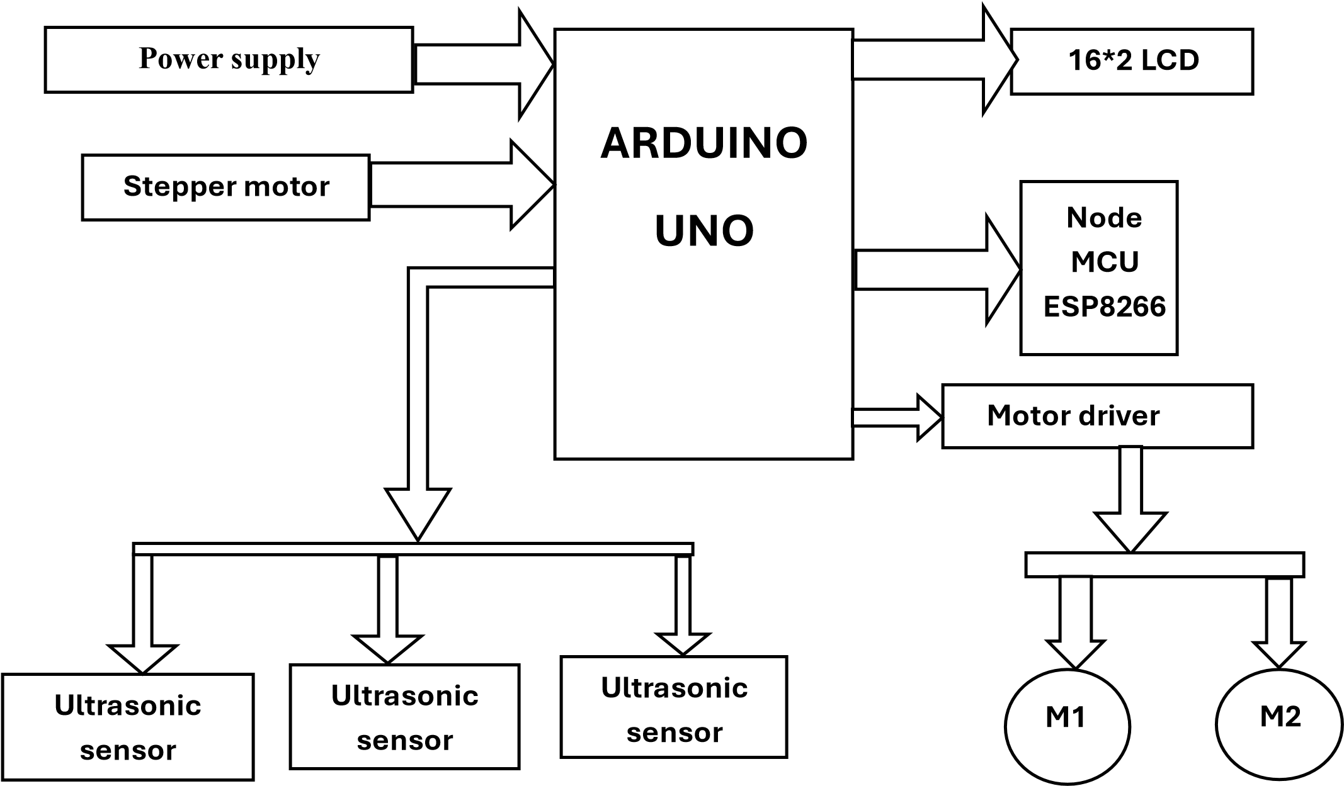
BLOCK DIAGRAM:

Slide 7
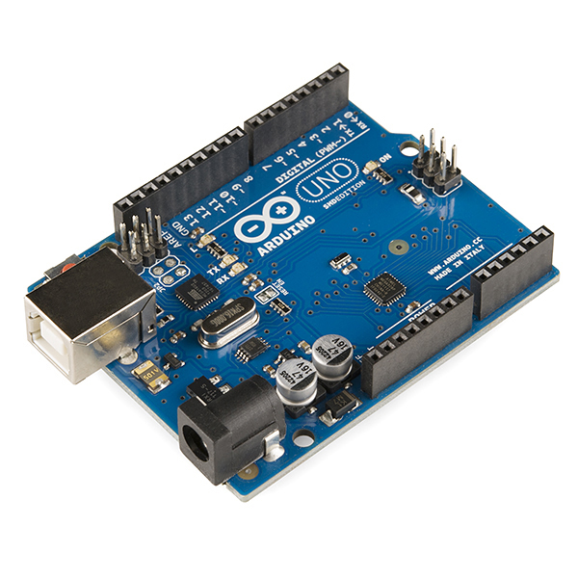
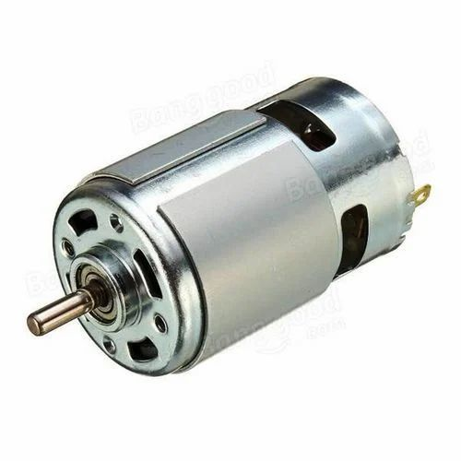
COMPONENTS:
ARDUNI UNO:
An Arduino Uno acts as the central control unit, processing sensor data from the environment, making decisions about movement and cleaning actions, and communicating with a smartphone app or cloud platform via a wireless module like Bluetooth, essentially "thinking" and directing the robot's cleaning operations based on real-time information and user commands.
14 Digital DO pins
-6 Analog input pins
-12 KB flash memory
-16 MHz clock speed
DC MOTOR:
The two DC motors allow the robot to move in forward, backward, left, or right directions. Depending on the signal received, the microcontroller adjusts the motor direction and speed for precise control. When the robot moves across the floor, the 5V water pump releases water for cleaning.

Slide 8
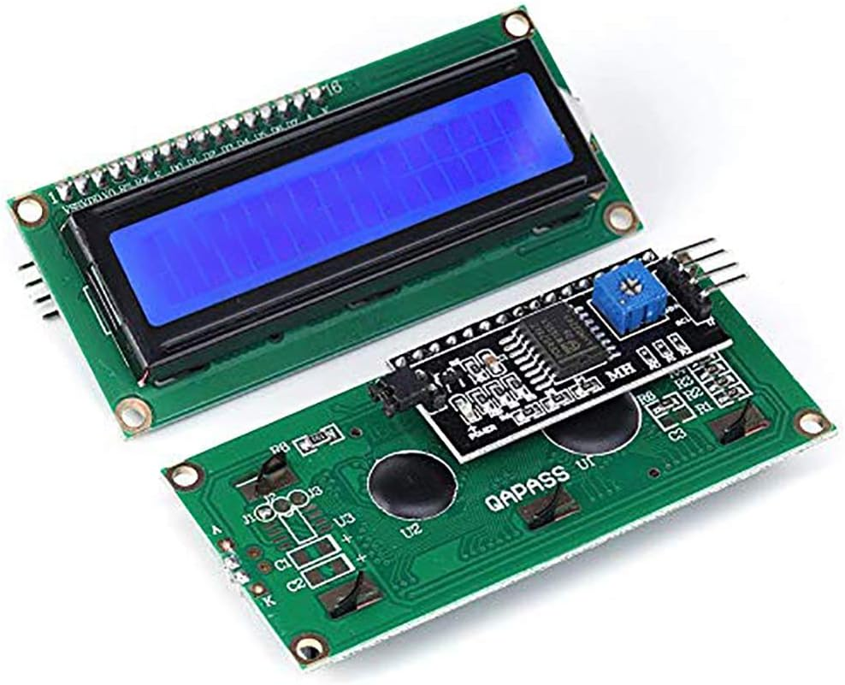
LCD DISPLAY:
1.Display Cleaning Mode: Show the current cleaning mode (e.g., "Auto", "Manual", "Spot Cleaning").
2. Display Battery Level: Show the remaining battery life (e.g., "80%", "50%", "20%").
3. Display Cleaning Progress: Show the progress of the cleaning task (e.g., "Cleaning...", " Completed").
4. Display Error Messages: Show error messages (e.g., "Obstacle detected", "Low battery").
5. Display IoT Commands: Show commands received from the IoT platform (e.g., "Start Cleaning", "Stop Cleaning").
6. Display Sensor Data: Show sensor data (e.g., temperature, humidity, dust levels).
specifications:
Operating Voltage:5V
Backlight colour: Green
Horizontal characters: 16
No of lines:2
Supports MCU speed up to 2Mhz

Slide 9
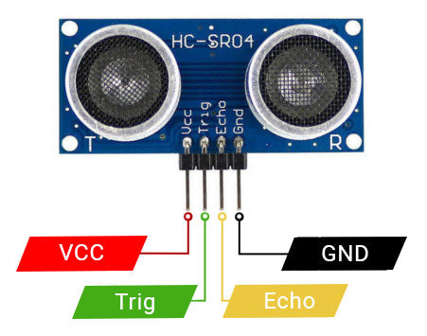
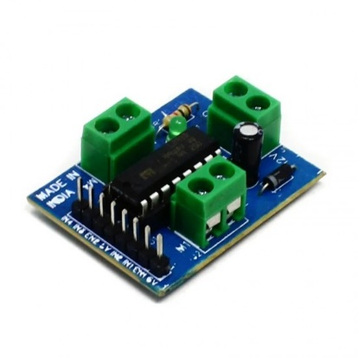
ULTRASONIC:
An ultrasonic sensor acts as a primary obstacle detection mechanism, allowing the robot to navigate around furniture, walls, and other objects by measuring the distance to them using sound waves, enabling it to avoid collisions and clean efficiently while maintaining autonomy.
Specifications:
Power Supply: DC 5V
Working Current: 15mA
Working Frequency: 40Hz
Ranging Distance : 2cm – 400cm
L293D:
The L293D is a 16 pin IC, with eight pins, on each side, dedicated to the controlling of a motor. There are 2 INPUT pins, 2 OUTPUT pins and 1 ENABLE pin for each motor 12931) consist of two H-bridge. H- bridge is the simplest circuit for controlling a low current rated motor.

Slide 10
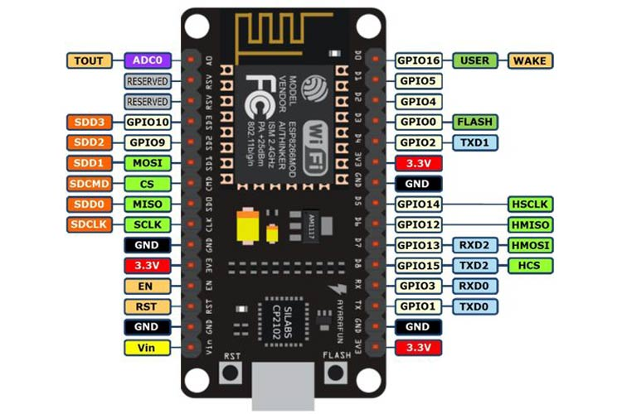
NODE MCU:
In a smart floor cleaning robot, a Node MCU acts as the "brain" - receiving information from sensors like obstacle detectors, processing that data, and sending commands to the robot's motors to navigate and clean the floor, all while allowing for wireless control through a smartphone app via its integrate WiFi capabilities: essentially, it manages the entire cleaning process, making decisions based on real-time sensor data to avoid obstacles and clean effectively.
Specifications:
Power supply:5v&3.3v
Range:802.11b/g/n
Digital I/O Pins: 16
Analog in pins: 1

Slide 11
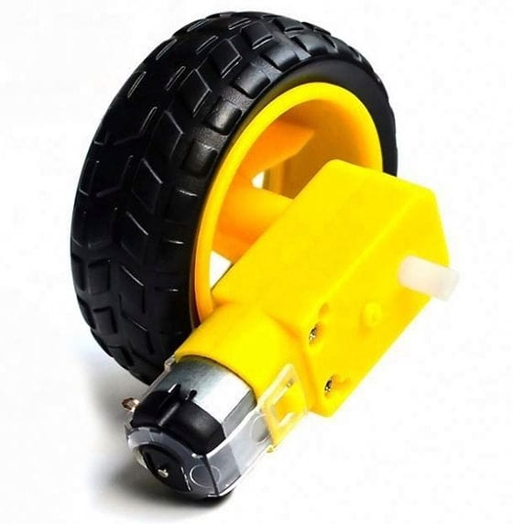
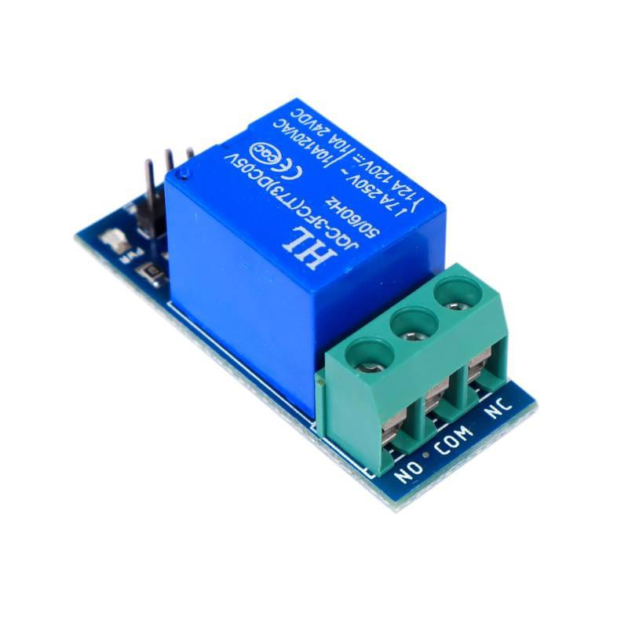
BO MOTOR:
A "BO motor" is a especially within the context of IoT, refers to a "Brushless DC (DC) motor" which is commonly used to power the wheels of the robot, enabling it to move around and clean the floor effectively due to its compact size, high efficiency, and low noise operation; making it a popular choice for such applications.
RELAY:
Relay is a electronic component that uses electromagnet to act as a mechanical switch The purpose of a relay in to switch on and off a high powered circuit . Relay provides the complete isolation between the low voltage circuit on Node MCU side and the high voltage side controlling the load
specifications:
Normal voltage 5V DC
Voltage supply ranges from 3.75v-6v
It includes 5pins
The maximum current is 10A

Slide 12
Working principle
Sensors and Navigation
Cleaning Mechanism
IOT Connectivity
Artificial Intelligence and Mapping
Battery and Charging
Data Collection and Monitoring
Automatic Scheduling

Slide 13
APPLICATIONS:
Home cleaning
Pet owners
Allergy sufferers
Factory floors
Transportation
Office cleaning
Public cleaning
Hotel and Hospitality cleaning

Slide 14
ADVANTAGES:
Time saving feature
Automated operation
Reduced human effort
Remote monitoring and control
Increased cleaning efficiency
Improved Accuracy
Increased productivity
Improved cleaning quality

Slide 15
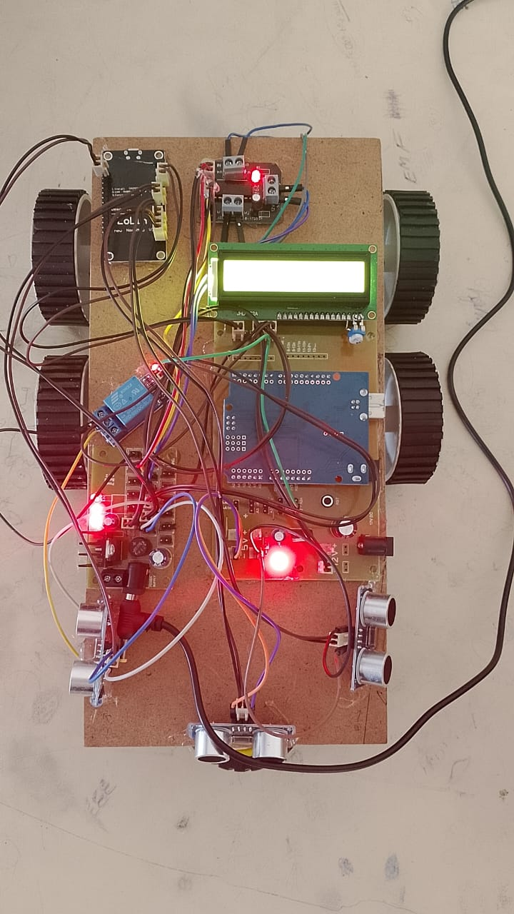
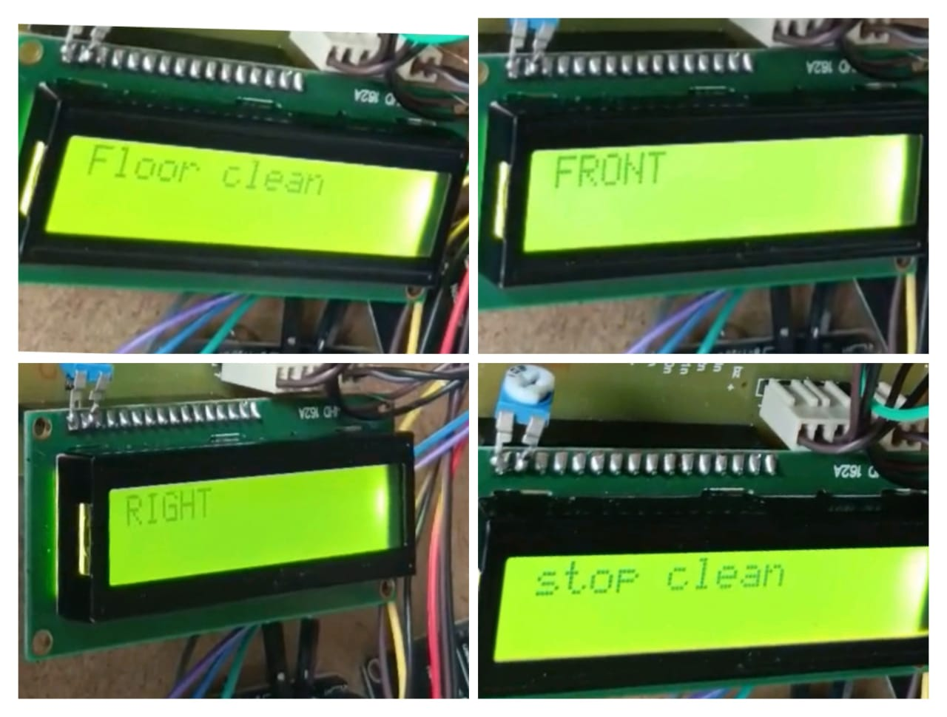

Slide 16
Conclusion:
In conclusion, the Smart Floor Cleaning Robot based on IoT revolutionizes cleaning tasks by increasing efficiency, improving accuracy, and enhancing convenience. With its advanced sensors and navigation systems, it optimizes cleaning paths and schedules, reducing labor costs and energy consumption. The robot's remote monitoring and control capabilities, scheduling, and notifications make it a valuable asset for smart homes, offices, and cities. As a cost-effective and environmentally friendly solution, the Smart Floor Cleaning Robot is poised to transform the cleaning industry, freeing up time for more productive tasks and paving the way for more automated future.

Slide 17


Slide 18


Slide 19
Future scope:
Artificial intelligence integration
Multi-functionality
Connectivity
Mobility
Efficiency

Slide 20
References:
kim j.of,oh j.,& park.j(2019). An Autonomous cleaning robot for multi-room indoor environments. International journal of precision engineering and technology,547-559.
Sorniotti . A & pagnoni .G(2019).autonomous floor cleaning robots: A review. Robotics and autonomous system, 121,103221.
Li W Li L.,Huang .D & Liu F(2019).A robotic vacuum cleaner based on human-robot interaction. Robotics and autonomous system. 118,53-65.
Choi Y.S & Ahn H.S (2019).A Hybrid cleaning Robot with vacuum and scrubber. Journal of intelligent & Robotic system. 93(3-4),661-673.
Bouguerra.S Lippiello.V & Parente.M (2019). Autonomous cleaning robots: State-of-the-art and new challenges. Robotics and Autonomous system . 114,113-131.

